Slide 1
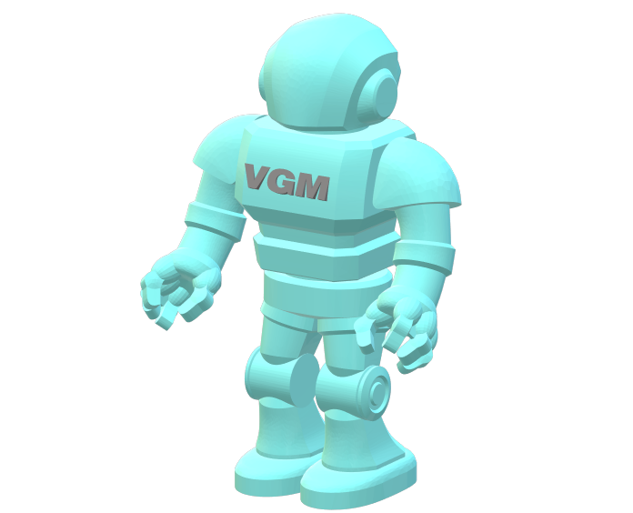
Vectric Gadget Man Dovetail Maker Version 5.0
May 2020

Slide 2

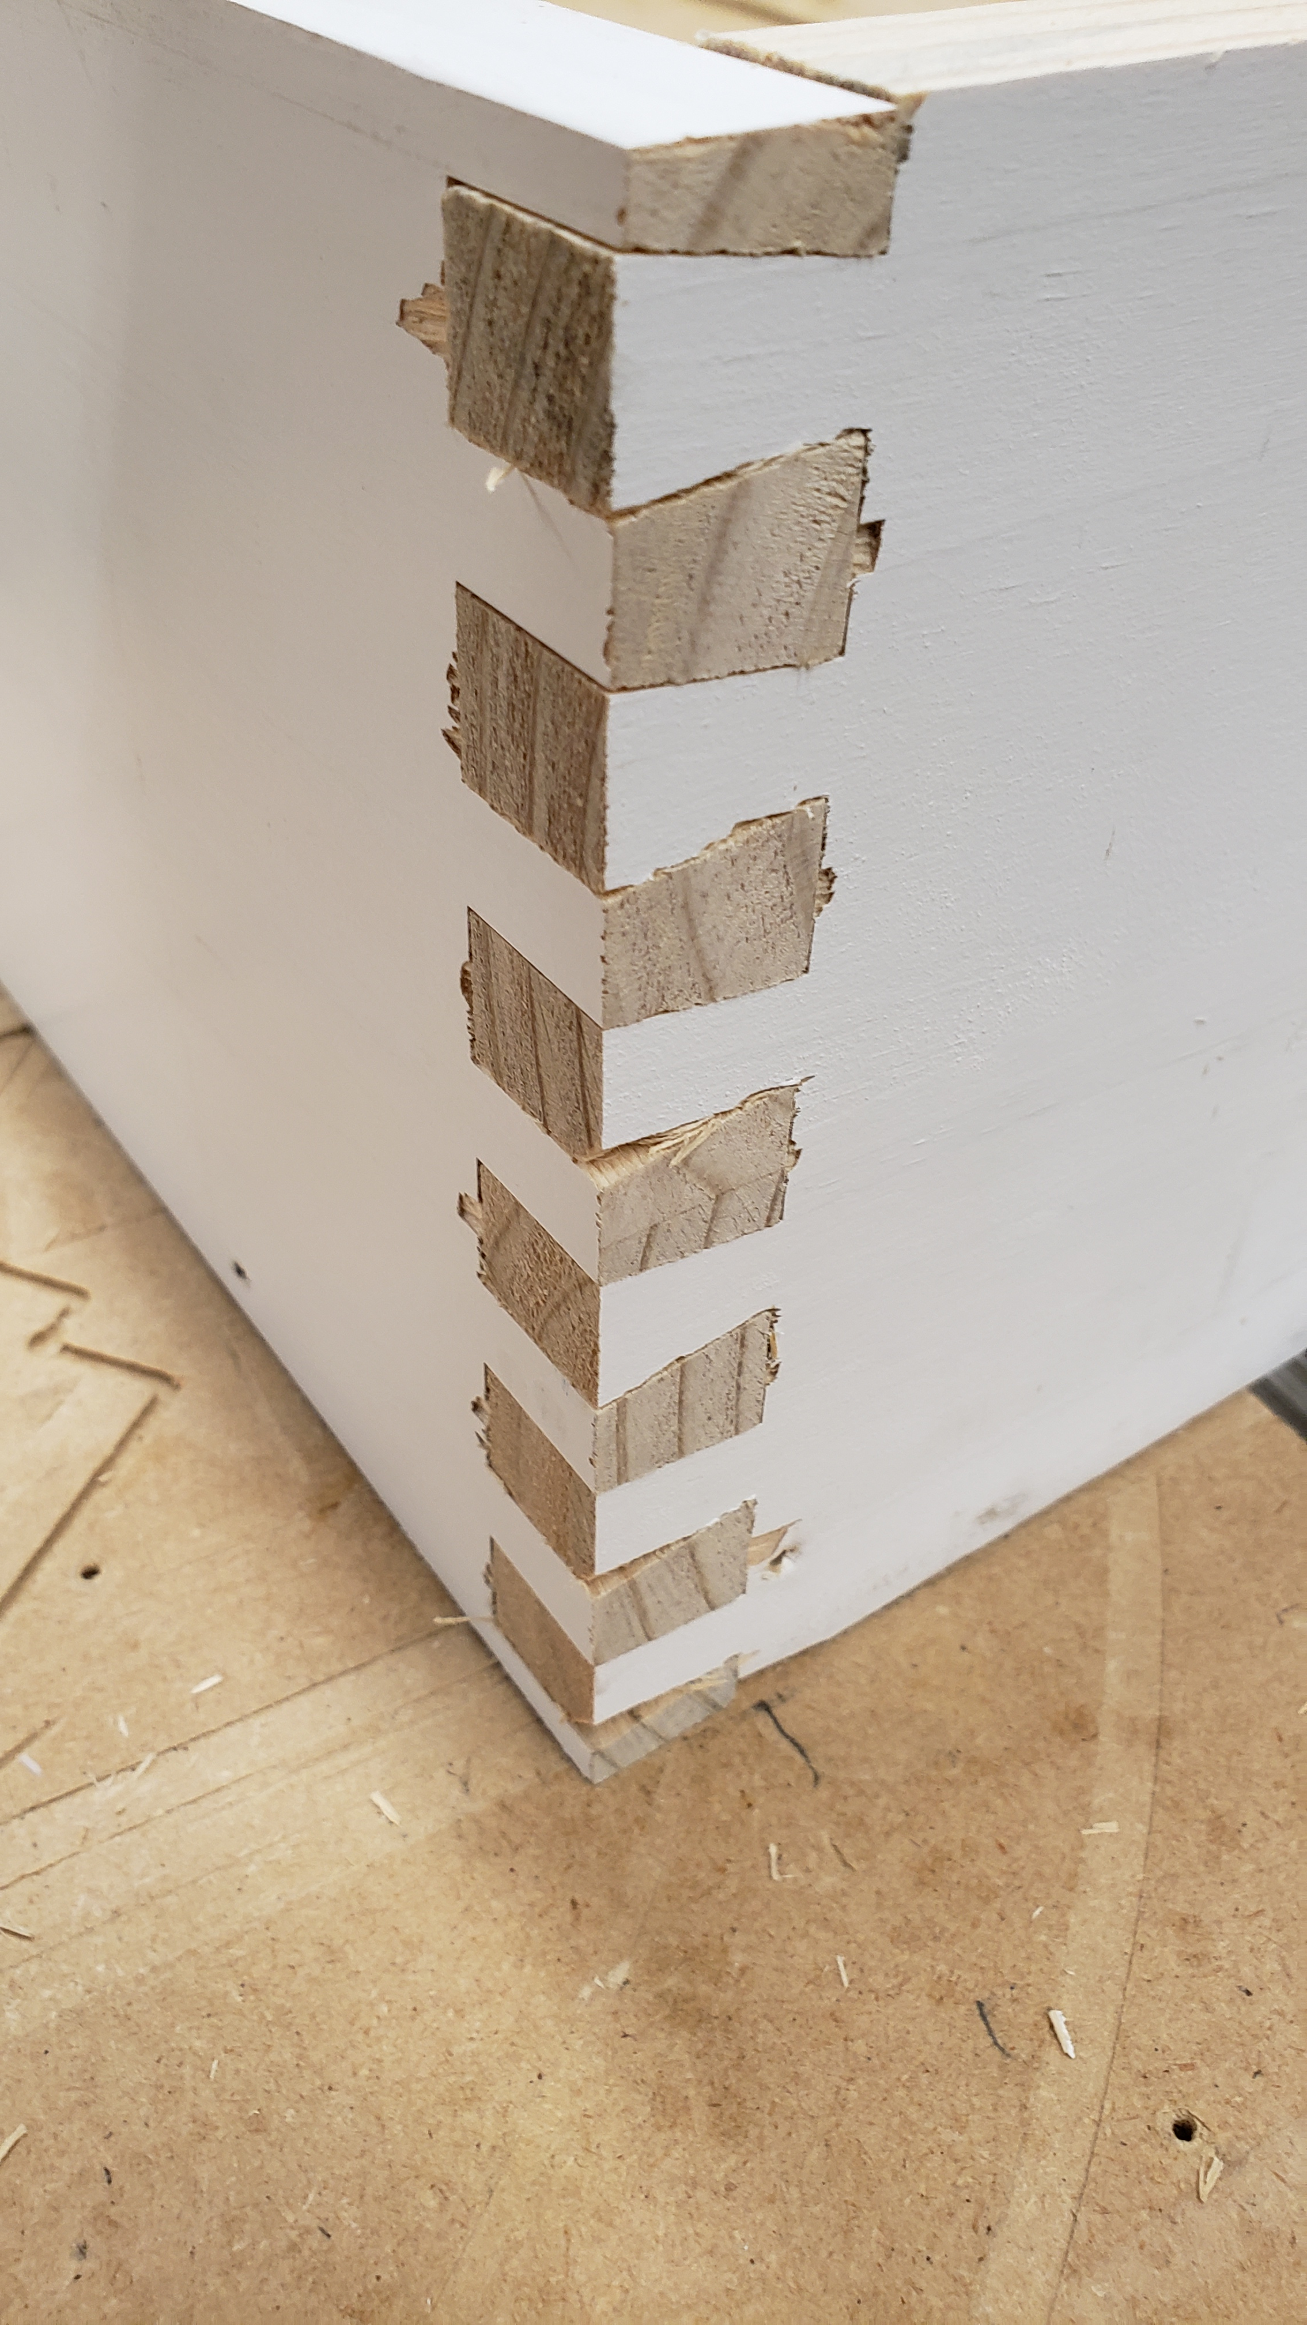
Dovetail Gadget Agenda
Job Setup
Running the Dovetail Gadget
Joint Setup
Making the Toolpaths
Testing the Fit
Please Note: This Gadget builds a Dovetail Joint by controlling the number of Tails and Pins equally over the size of material by entering the number of dovetails in the joint. The Bit selected plays a large role in the joint settings.

Slide 3
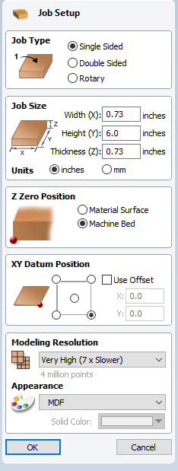
Dovetail Gadget Job Setup
Job Size – Width: Set to your material thickness
Job Type – Set to ‘Single Sided’
Milling operation is on the End of the material
Job Size – Height: Set to your material Width
Job Size – Units: Set to Your Units
Job Size – Thickness: Set to your material thickness
Z Zero Position – Set to ‘Your Style of Milling’
I use ‘Machine Bed’
XY Datum Position –Set to your Mill
I use the Lower Right on my Mill configuration

Slide 4
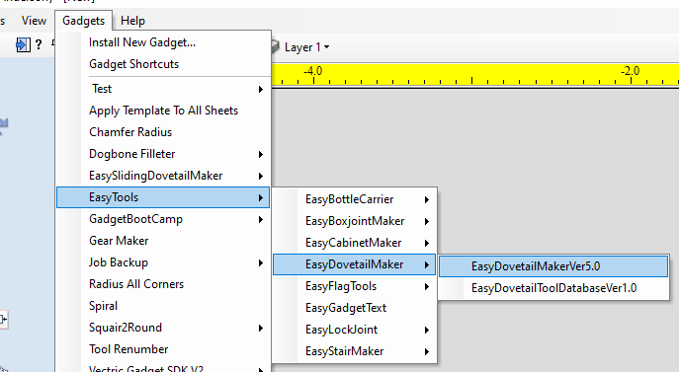
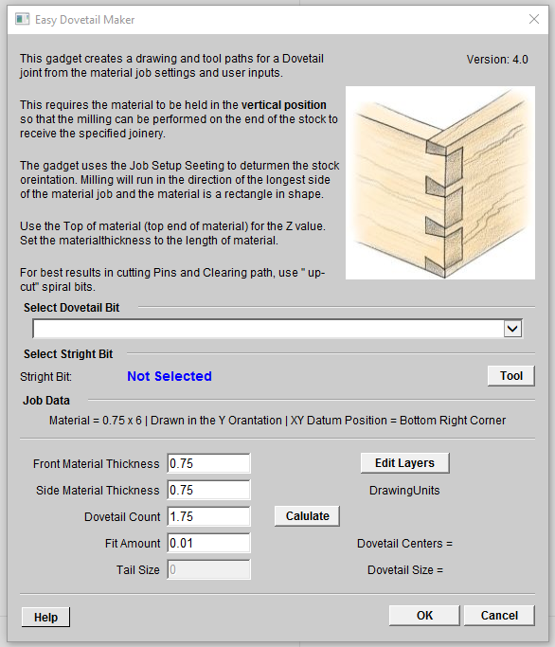
Dovetail Gadget Running the Dovetail Gadget
Version 10 or higher - Select Tool From The Tool Database
----------------------------
Version 9 or lower – Enter The Tool Diameter
Run Easy Dovetail Gadget

Slide 5
Dovetail Gadget Running the Dovetail Gadget
Drop the list to select a Dovetail From The Tool Dovetail Database

Slide 6

Dovetail Gadget Running the Dovetail Gadget
Select a Dovetail bit

Slide 7
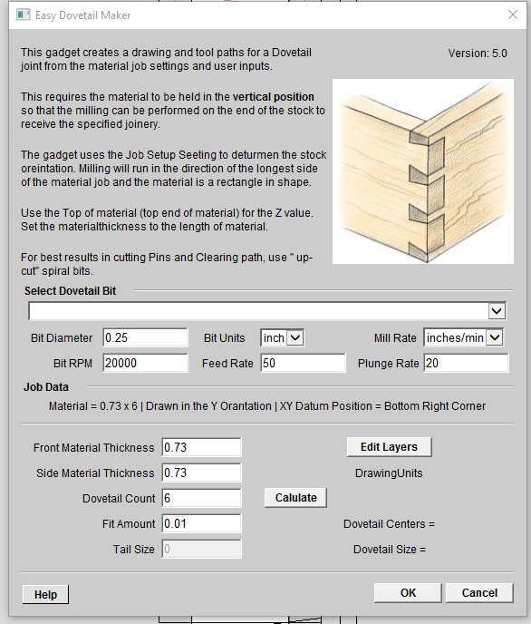

Dovetail Gadget Running the Dovetail Gadget
Version 10 - Select a straight Tool from the standard Tool database
Version 9 – Enter the tool data for the straight bit

Slide 8
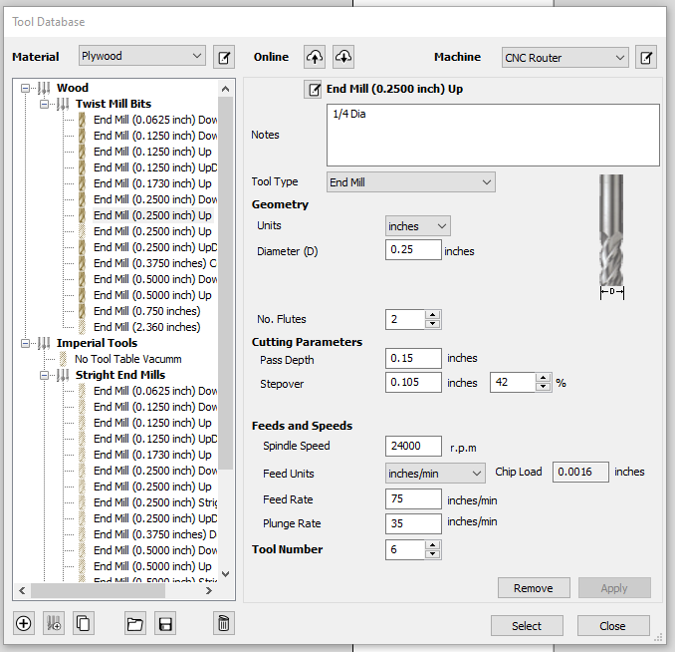
Dovetail Gadget Running the Dovetail Gadget
Select a Tool Diameter smaller or equal to the slot size. You may have to re-select if required

Slide 9
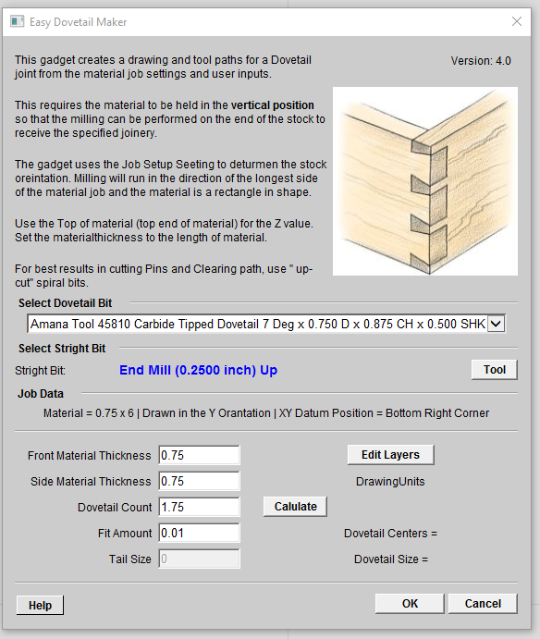
Dovetail Gadget Running the Dovetail Gadget
Note: Job data is displays here
Displays the Tool Selected
Note: Front and Side material thickness can be adjusted based your needs
Display the Layer and Tool-path naming dialog
Select the Calculate button to display the Joint data
Enter the number of Dovetail for the joint
You can adjust the fit with entering a value here

Slide 10
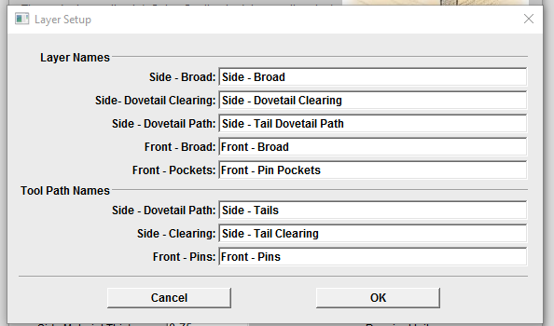
Dovetail Gadget Running the Dovetail Gadget
Edit Layer and Tool-path names

Slide 11

Dovetail Gadget Running the Dovetail Gadget
Select the Calculate button to display the Joint data
Enter the number of Dovetail for the joint

Slide 12
Dovetail Gadget Running the Dovetail Gadget
Select the OK button to build the drawing and toolpaths

Slide 13
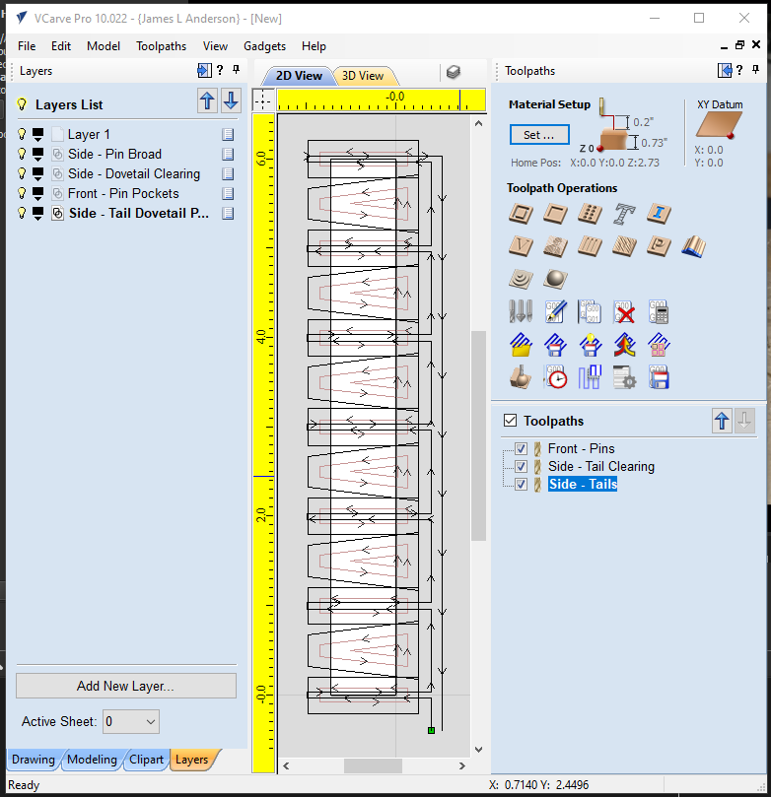
Dovetail Gadget
Note: The Layers are named so each milling of the Dovetail joint
Toggle on and off layers to display the Joint cuts
Note: The tool-paths for milling the dovetails

Slide 14
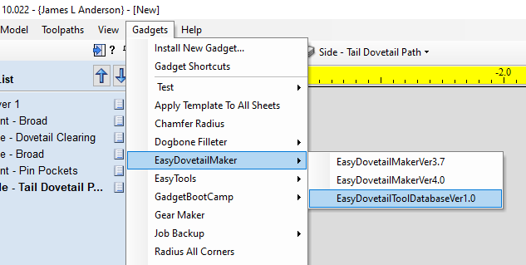
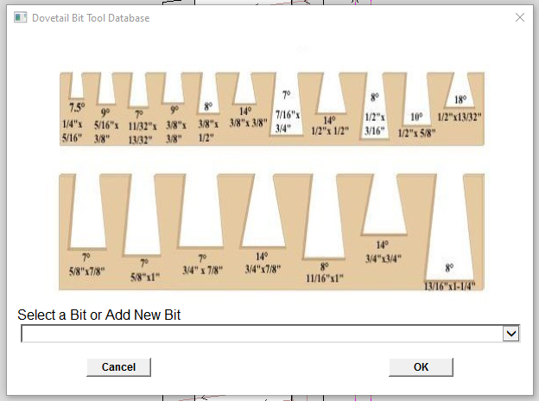
Dovetail Bit Gadget Adding and Editing Dovetail Bits
Open the Dovetail Tool Database Gadget
Select the Add New or Select a bit to edit

Slide 15
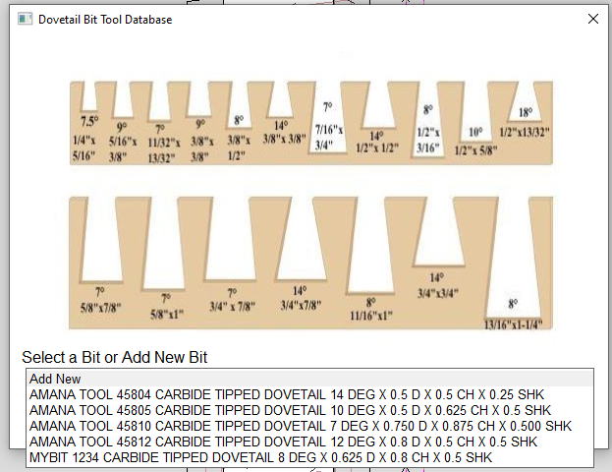
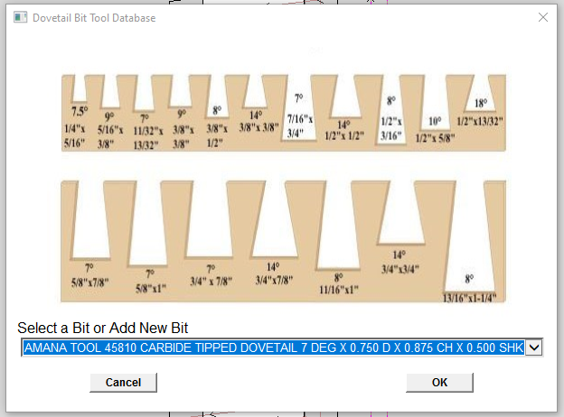
Dovetail Bit Gadget Adding and Editing Dovetail Bits
Select Add New or Select a bit to edit
Select the OK button to Open the

Slide 16
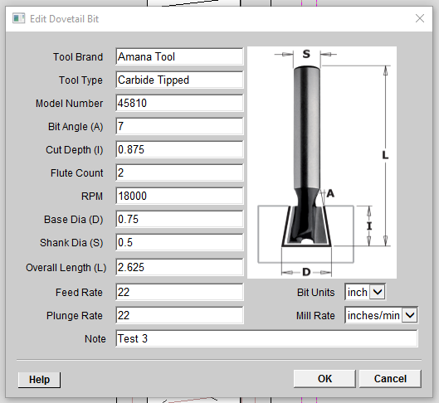
Dovetail Bit Gadget Adding and Editing Dovetail Bits
Update the tool data as needed
Select the OK button to save your changes

Slide 17
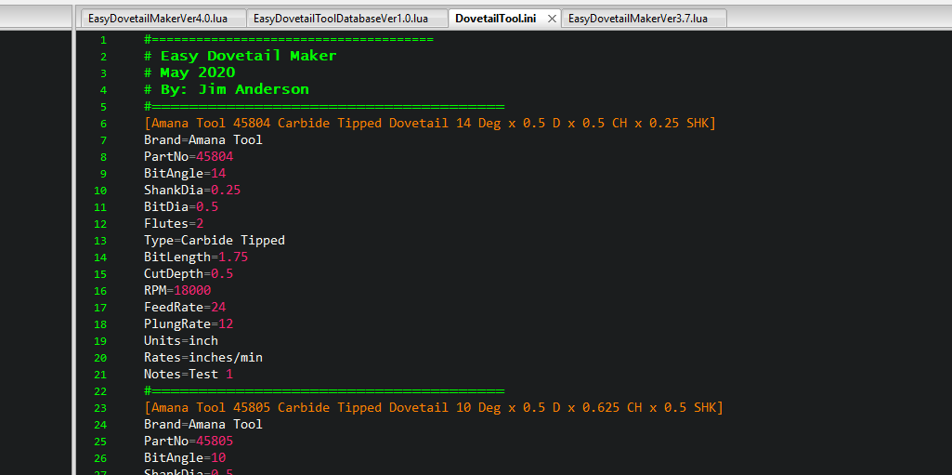
Dovetail Bit Gadget Adding and Editing Dovetail Bits
Note: If needed, You can edit the Dovetail bit database in any Text editor

Slide 18
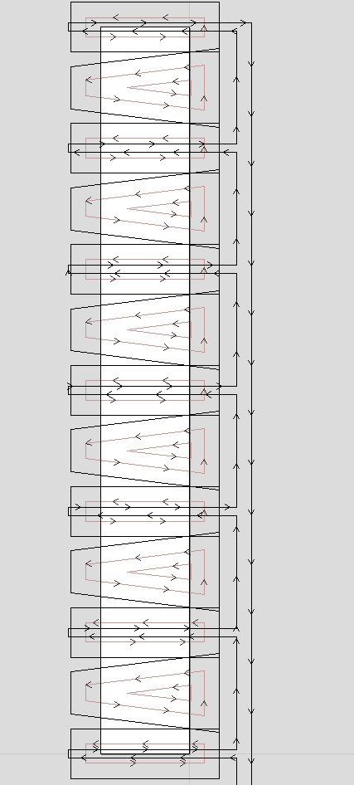
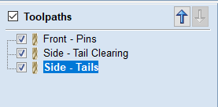
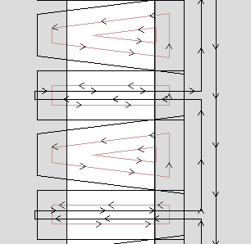
Dovetail Gadget Mill Setup
Note: The Fit adjustment is integrated in the Dovetail path geometry.
Note: The Milling is by Side or Front board

Slide 19
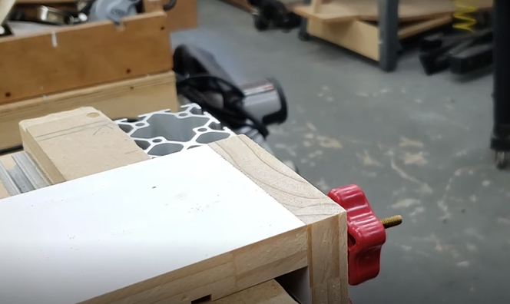
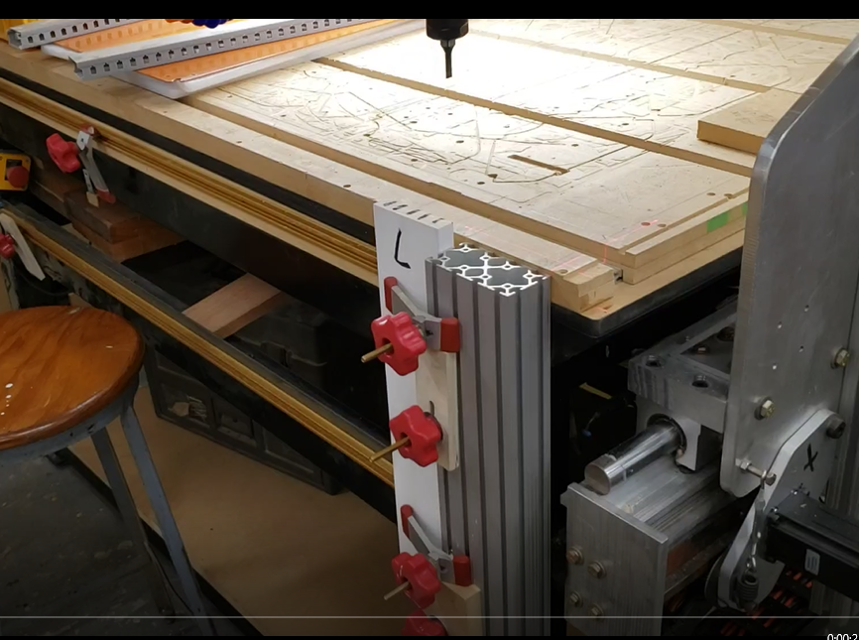
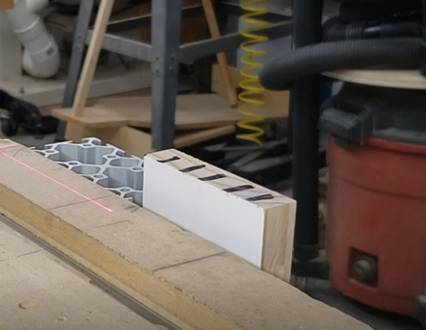
Dovetail Gadget Running the parts
Note: Use material to flush the top so it is projected above the mill table.
Note: Material is clamped to the front of the mill and is projected the thickness of the material above the mill table.
Note: Remove material as shown here.

Slide 20


